Slide 1
Introduction
簡廷因 Ting-Ying Chien
2017.02.21

Slide 2
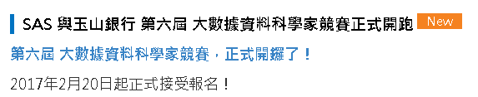
FYI
SAS 與玉山銀行 第六屆 大數據資料科學家競賽
玉山銀行與SAS公司共同主辦
http://saschampion.com.tw/
報名時間: 2017/2/20 ~ 2017/3/10

Slide 3
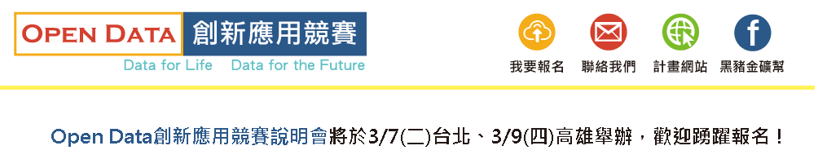
FYI
Open Data創新應用競賽
https://opendata-contest.tca.org.tw/purpose.aspx
報名時間: ~ 2017/4/13

Slide 4
What is Big Data?
Big data usually includes data sets with sizes beyond the ability of commonly used software tools to capture, curate, manage, and process data within a tolerable elapsed time.
Big data "size" is a constantly moving target, as of 2012 ranging from a few dozen terabytes to many petabytes of data. Big data is a set of techniques and technologies that require new forms of integration to uncover large hidden values from large datasets that are diverse, complex, and of a massive scale.

Slide 5
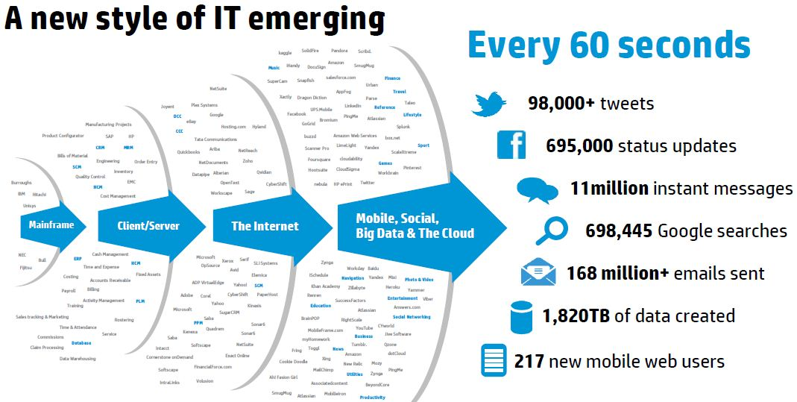
What is Big Data?
Ref : https://practicalanalytics.wordpress.com/2012/10/22/sizing-mobile-social-big-data-stats/

Slide 6
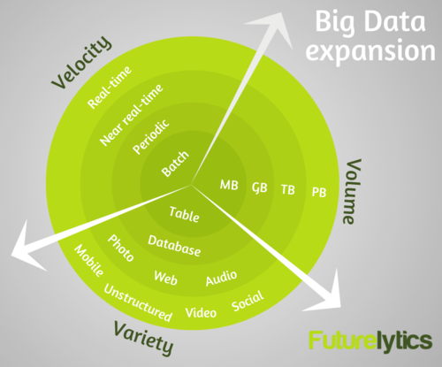
What is Big Data?
3V
Volume
Velocity
Variety
Ref : http://blog.futurelytics.com/2014/04/what-is-big-data-and-why-should-you-care/

Slide 7
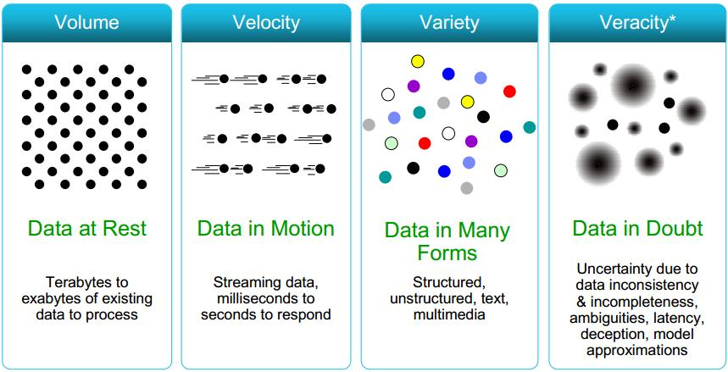
What is Big Data?
4V
Volume
Velocity
Variety
Veracity
ref : http://www.datasciencecentral.com/profiles/blogs/data-veracity

Slide 8
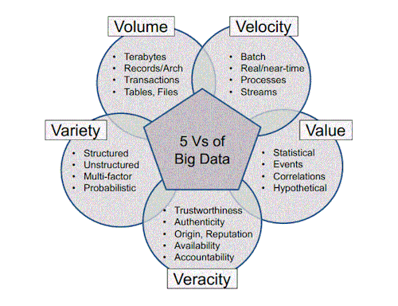
What is Big Data?
5V
Volume
Velocity
Variety
Veracity
Value
Ref :http://andressilvaa.tumblr.com/post/87206443764/big-data-refers-to-5vs-volume

Slide 9
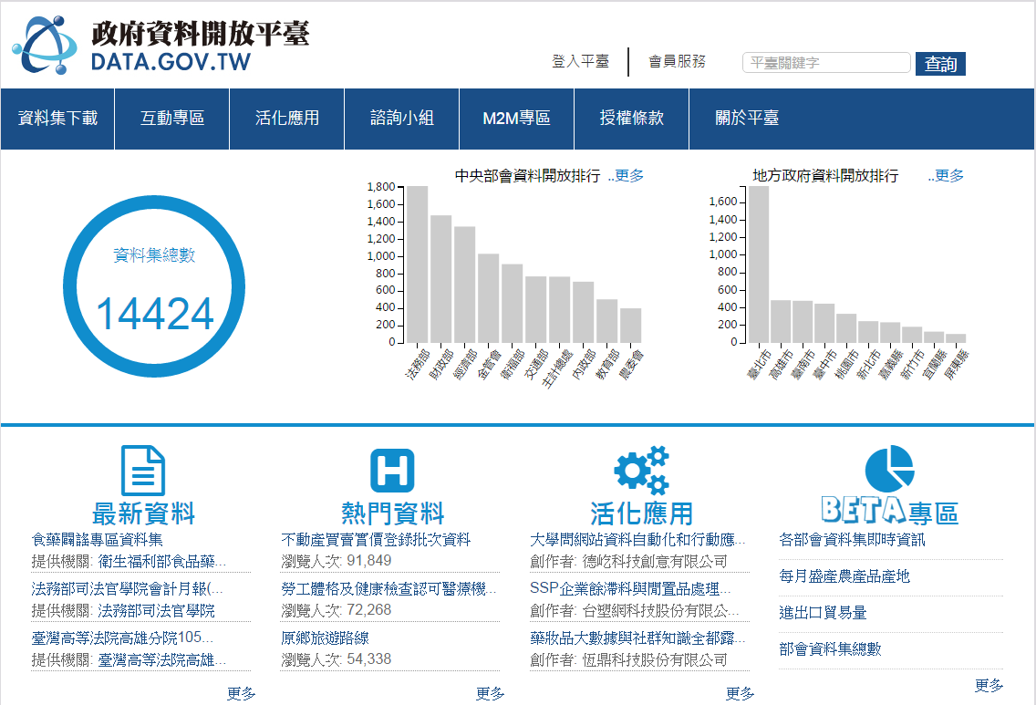
Where is data?
Government
Open data
http://data.gov.tw/
http://data.coa.gov.tw/
https://dbahr.narlabs.org.tw/
http://taqm.epa.gov.tw/taqm/tw/default.aspx
https://nycopendata.socrata.com/
...
Private data
National Health Insurance Research Database (健保資料庫)
Electronic Receipts Database
ETC
http://cit-etc.net1.tw/honor-ok.asp
…

Slide 10
Where is data?
Business Data
Customer data
Manufacturing data
…
Competitions
http://www.kaggle.com/competitions
http://dreamchallenges.org/
…

Slide 11
Where is data?
Social Media
FB
Twitter
Plurk
PTT
Mobile01
…

Slide 12
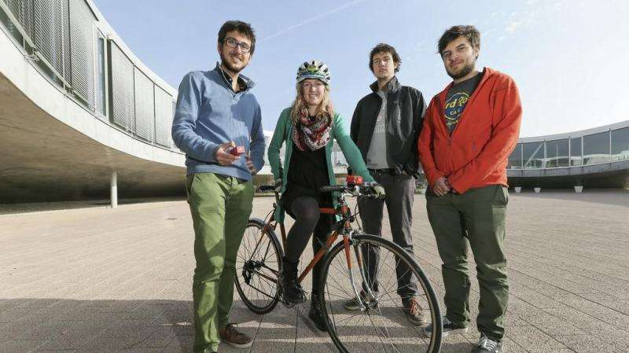
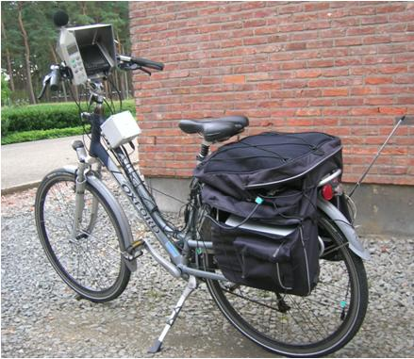
Where is data?
Resident
1999 in Taiwan (311 in New York City)
Ubike
Air pollution data
Ref: http://phys.org/news/2015-11-air-pollution-bicycle.html
Ref: http://www.mdpi.com/1424-8220/13/1/221

Slide 13
Examples of Big data application
Consumer recommendations, and merchandising
Netflix
http://techblog.netflix.com/2014/10/using-presto-in-our-big-data-platform.html
http://www.huffingtonpost.com/markus-giesler/netflixs-transformation-big-data-vs-big-sociology-_b_5985428.html
Amazon
PCHOME
YAHOO
eBay

Slide 14
Examples of Big data application
Finance and economics
stock
http://www.forbes.com/sites/timworstall/2014/08/04/big-data-using-google-searches-to-predict-stock-market-falls/
foreign currency
http://technews.tw/2015/02/10/wall-street-manipulate-currency-exchange/

Slide 15
Examples of Big data application
Campaign
Obama
https://datafloq.com/read/big-data-obama-campaign/516
http://www.infoworld.com/article/2613587/big-data/the-real-story-of-how-big-data-analytics-helped-obama-win.html
柯文哲
http://www.ettoday.net/news/20141203/434258.htm

Slide 16
Examples of Big data application
Others
Google ads.
Facebook
http://www.pnas.org/content/111/24/8788.full
Boost Weather Forecasting
http://www.research.ibm.com/articles/brunei.shtml

Slide 17
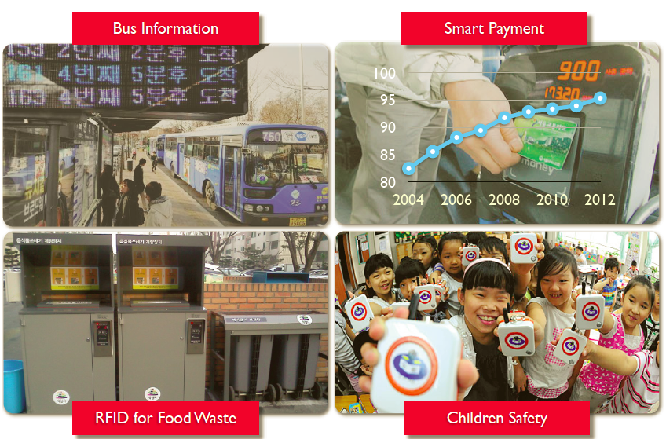
Examples of Big data application

Slide 18
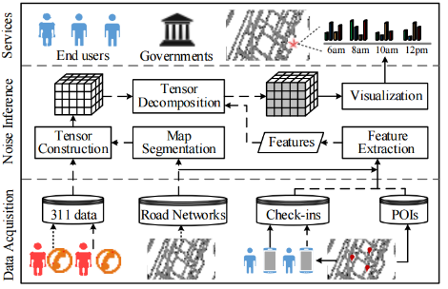
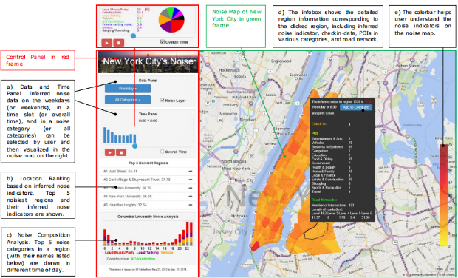
Examples of Big Data Application
Noise detection
Y. Zheng, T. Liu, Y. Wang, Y. Zhu, Y. Liu, E. Chang
"Diagnosing New York city's noises with ubiquitous data"
Y. Wang, Y. Zheng, T. Liu "A Noise Map of New York City“

Slide 19
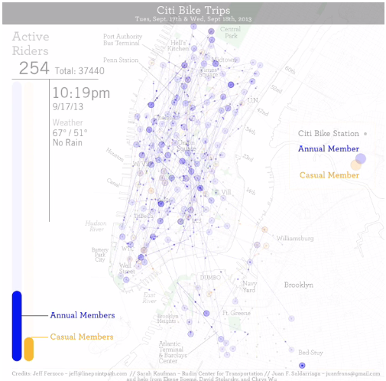
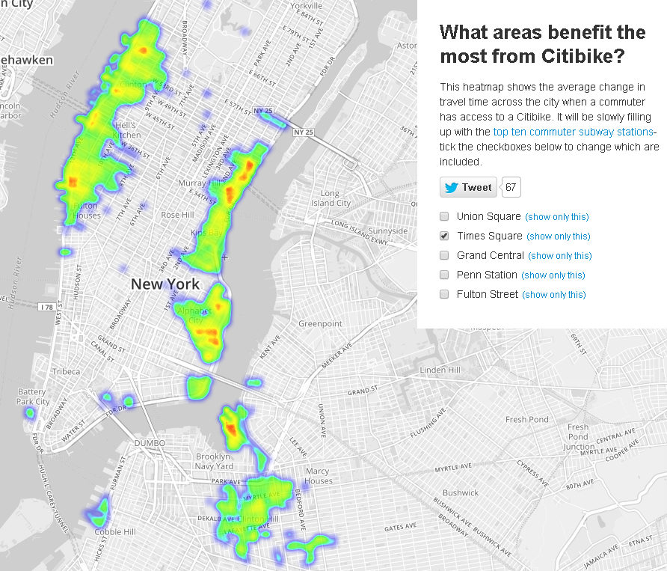
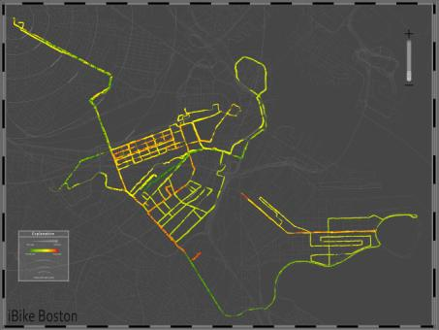
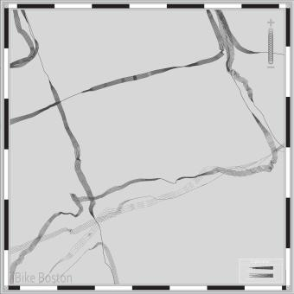
Examples of Big Data Application
City bike Application

Slide 20
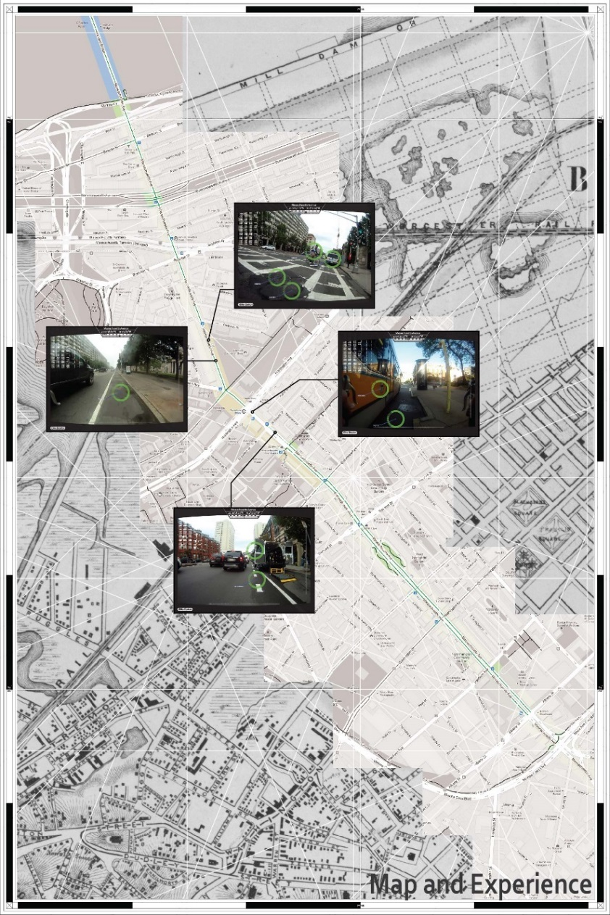
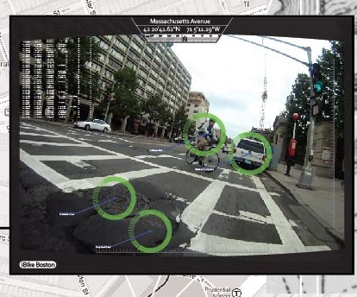
Examples of Big Data Application
City bike application

Slide 21
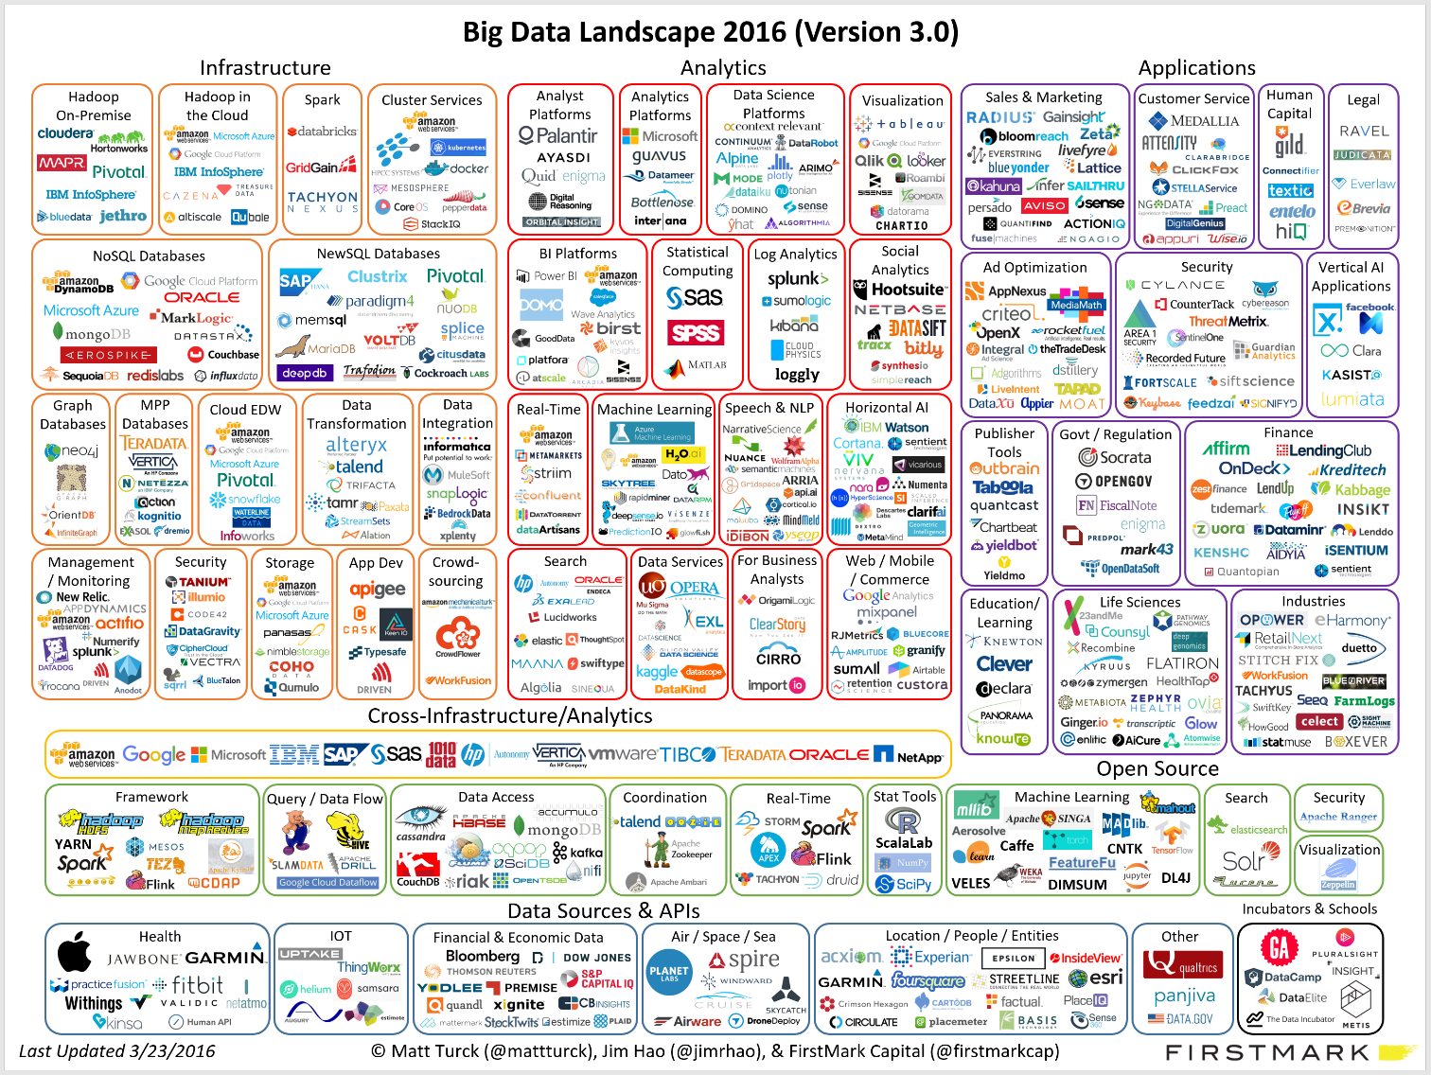
Big data Landscape

Slide 22
20 Highest Paying Jobs in America for 2016
Jobs | Median Base Salary | Number of Job Openings
Physician | $180,000 | 2,064
Lawyer | $144,500 | 995
Research & Development Manager | $142,120 | 112
Software Development Manager | $132,000 | 3,495
Pharmacy Manager | $130,000 | 1,766
Strategy Manager | $130,000 | 701
Software Architect | $128,250 | 655
Integrated Circuit Designer Engineer | $127,500 | 165
IT Manager | $120,000 | 3,152
Solutions Architect | $120,000 | 2,838
Engagement Manager | $120,000 | 1,452
Applications Development Manager | $120,000 | 263
Pharmacist | $118,000 | 4,502
Systems Architect | $116,920 | 439
Finance Manager | $115,000 | 2,582
Data Scientist | $115,000 | 1,985
Risk Manager | $115,000 | 1,137
Creative Director | $115,000 | 696
Actuary | $115,000 | 175
Data Architect | $113,000 | 762
ref :https://www.glassdoor.com/blog/25-highest-paying-jobs-america-2016/

Slide 23
Big Data Analytics Framework

Slide 24
Research framework
1. Problem Definition
2. Data Preparation
3. Data Mining & Machine Learning
4. Evaluation & Interpretation

Slide 25

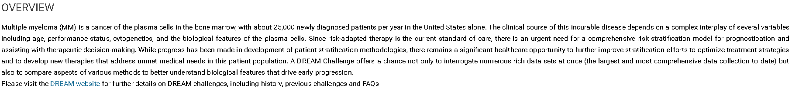
Problem Definition
Example:
Ref: https://www.synapse.org/#!Synapse:syn6187098/wiki/401884

Slide 26
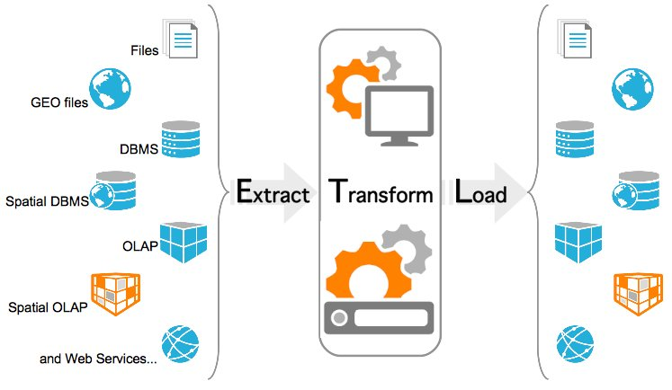
Data Preparation
ETL

Slide 27
Data Format
Structured Data
TXT
CSV
SQL
XML (eXtensible Markup Language)
JSON (JavaScript Object Notation)
…
Unstructured data
Image
Video
Voice
…

Slide 28
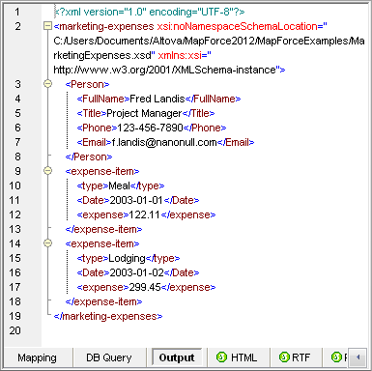
Data Format
XML (eXtensible Markup Language)
are three common terms used to describe parts of an XML document:
tags
elements
attributes
<people>
<person id="person_1">
<name>David</name>
<date>2014-01-30</date>
</person>
</people>

Slide 29
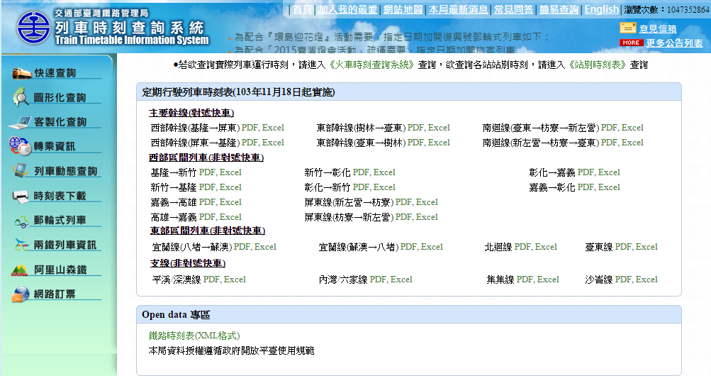
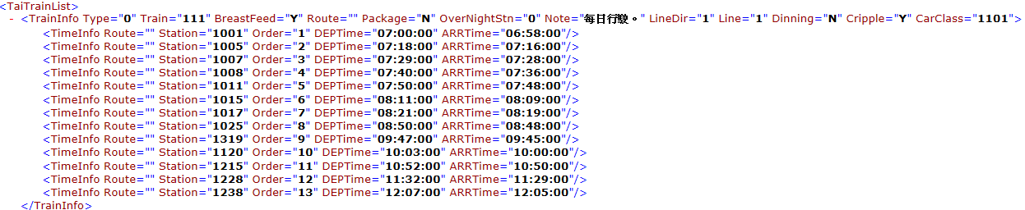
Data Format
XML example

Slide 30
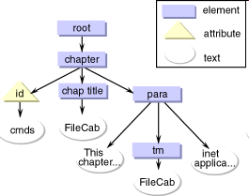
Data Format
XML document as a tree
Conceptually, an XML document is a hierarchical structure called an XML tree

Slide 31
Data Format
JSON (JavaScript Object Notation)
A lightweight computer data interchange format
Text-based, human-readable format for representing simple data structures and associative arrays
easy for humans to read and write
easy for machines to parse and generate
Based on a subset of the JavaScript programming language

Slide 32
Data Format
{
"firstName": "John",
"lastName": "Smith",
"age": 25,
"address": {
"streetAddress": "21 2nd Street",
"city": "New York",
"state": "NY",
"postalCode": "10021"
},
"phoneNumber": [
{
"type": "home",
"number": "212 555-1234"
},
{
"type": "fax",
"number": "646 555-4567"
}
],
"gender": {
"type": "male"
}
}
JSON Example

Slide 33
Data Format
JSON to XML
XML to JSON
<Book> <Title>Parsing Techniques</Title> <Authors> <Author>Dick Grune</Author> <Author>Ceriel J.H. Jacobs</Author> </Authors> <Date>2007</Date> <Publisher>Springer</Publisher> </Book>
{ "Book": { "Title": "Parsing Techniques", "Authors": [ "Dick Grune", "Ceriel J.H. Jacobs" ], "Date": "2007", "Publisher": "Springer" } }

Slide 34
Data Format
An XML document is a tree
<Book> <Title>Parsing Techniques</Title> <Authors> <Author>Dick Grune</Author> <Author>Ceriel J.H. Jacobs</Author> </Authors> <Date>2007</Date> <Publisher>Springer</Publisher> </Book>
Book
Authors
Title
Date
Publisher
Author
Author
Parsing Techniques
Dick Grune
Ceriel J.H. Jacobs
2007
Springer

Slide 35
Data Format
A JSON Object is a tree
{ "Book": { "Title": "Parsing Techniques", "Authors": [ "Dick Grune", "Ceriel J.H. Jacobs" ], "Date": "2007", "Publisher": "Springer" } }
Book
Authors
Title
Date
Publisher
["Dick Grune", "Ceriel J.H. Jacobs"]
Parsing Techniques
2007
Springer

Slide 36
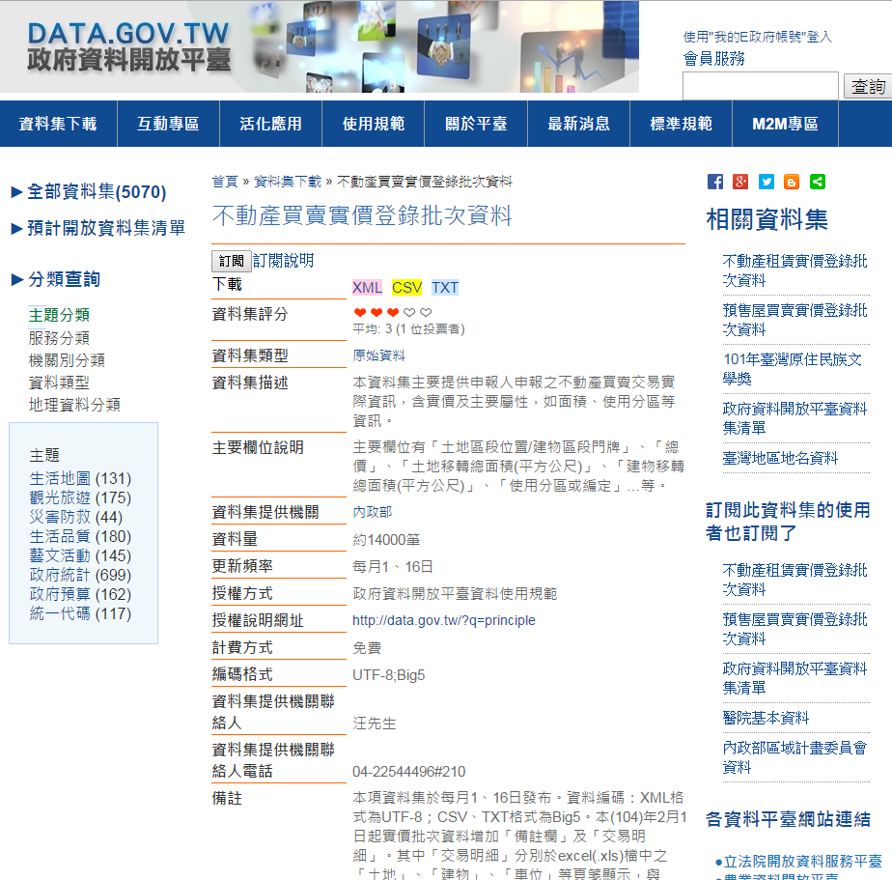
Example

Slide 37
Data Mining & Machine Learning
Data Mining
Data Clustering
Data Classification
…
Machine Learning
libSVM
KNN
Bayesian networks
…

Slide 38
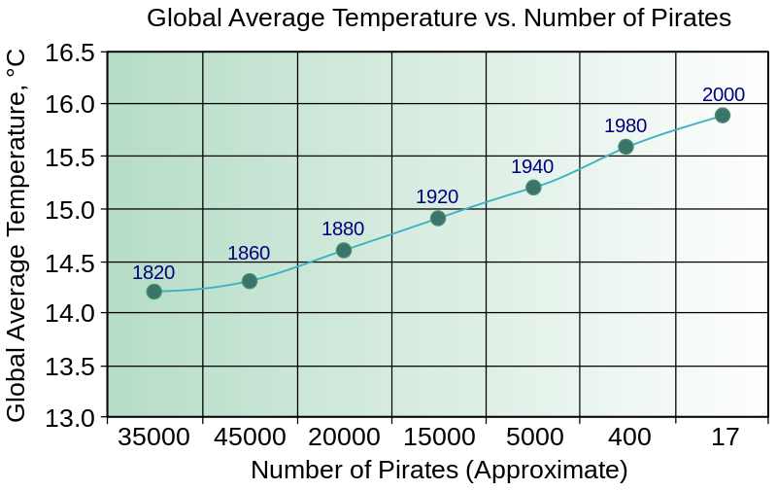
Evaluation & Interpretation
correlation does not imply causation
http://en.wikipedia.org/wiki/Correlation_does_not_imply_causation
pirates cause global warming??

Slide 39
Q&A

